Slide 1

Sitecore 9.3 Training Day - 1
Balaji Balasubramanian

Slide 2

Balaji balasubramanian
About Me
Principal Architect
12+ Experience (.net)
6+ Exp in Sitecore
Sitecore versions – 6.5,7.2,8.2,9.2,10.1(latest)

Slide 3
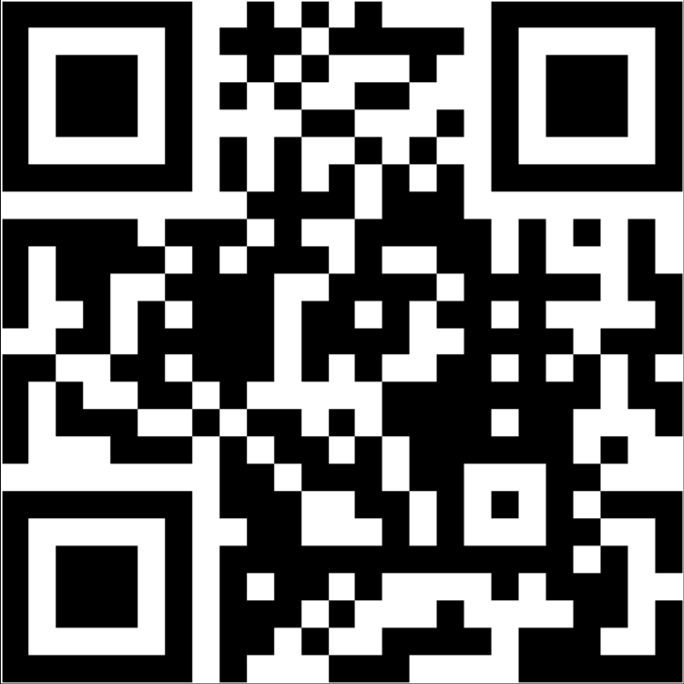
Survey
About your Sitecore experience
https://www.menti.com/ifm9js6dop
Or
Go to www.menti.com and use the code 5153 6538
Or
Scan the QR Code

Slide 4
Agenda
Sitecore Basics
About Sitecore
Sitecore different User Interface
Sitecore Content Tree ( Content ,Forms , Layout , media Library, System & templates)
Content Editor & Experience Editor overview
Template
Field Types(SLT,MLT, Image, Rich Text)
Standard Values
Insert Options
Item Versions
Field Level Validation (compliance/Content Authoring)
Quick Action Bar
Validation Bar
Validation Button
Spell Check
Site Improve Tool for compliance

Slide 5
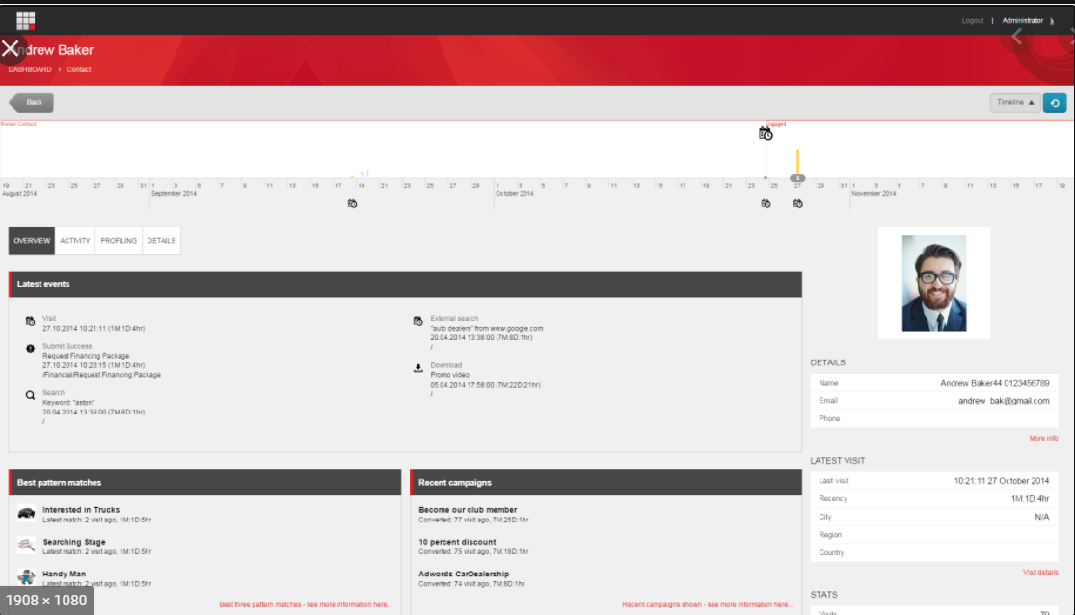
Experience Profile

Slide 6
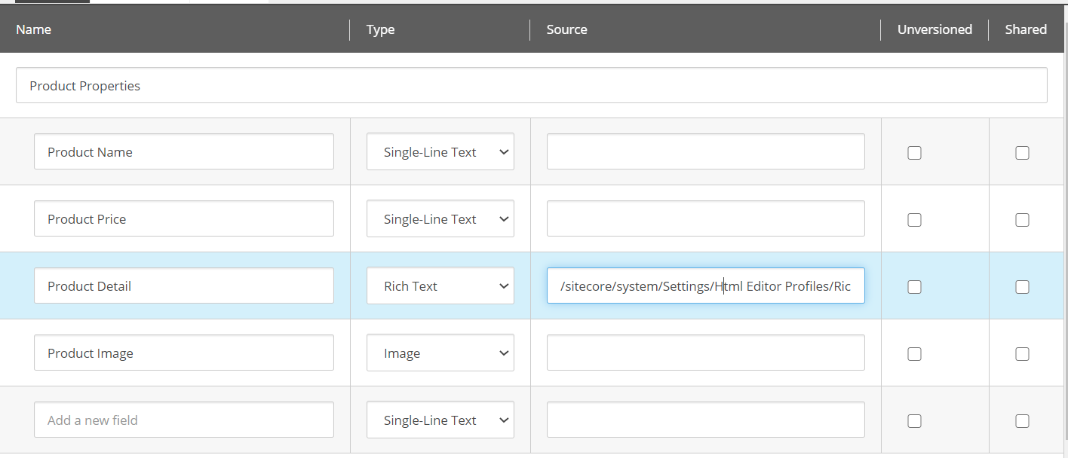
Template
Field Types

Slide 7
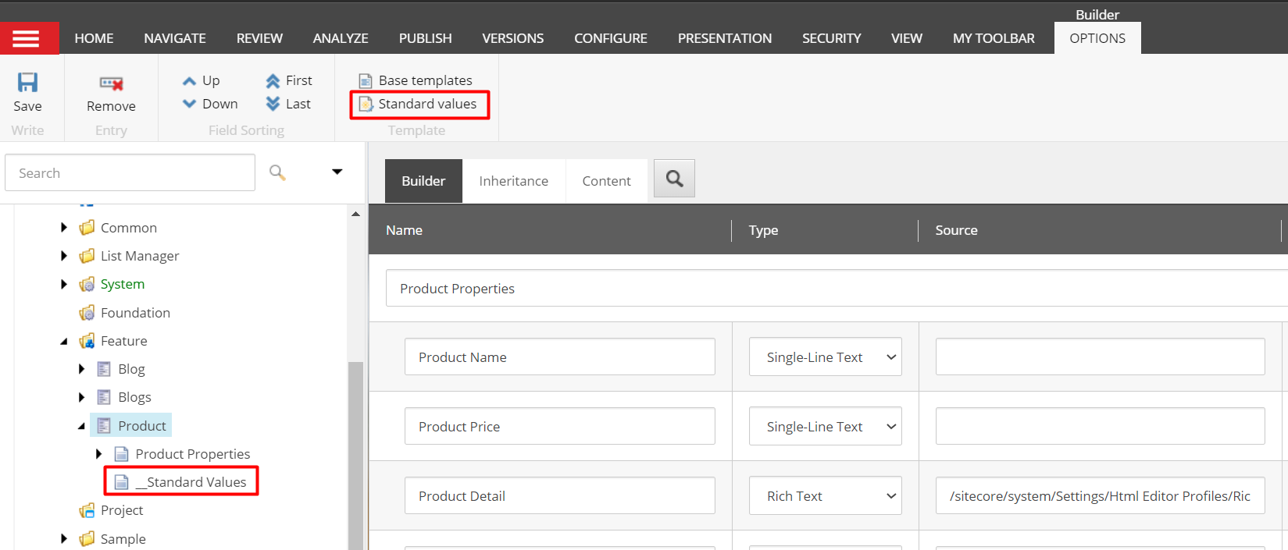
Template
Standard Values

Slide 8
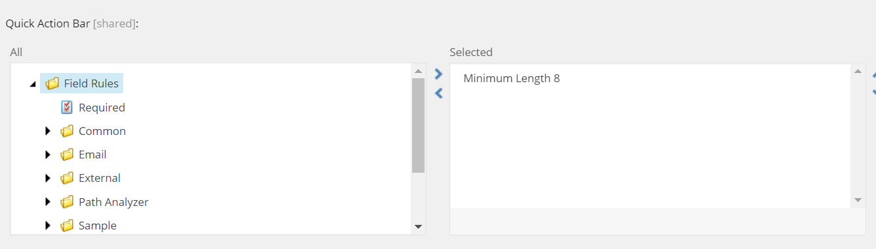
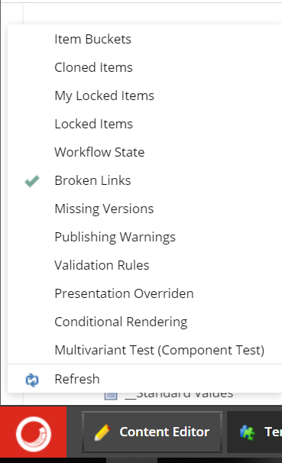
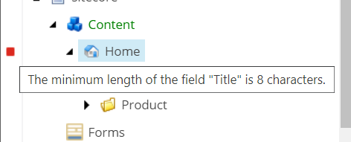
Quick Action bar
Configuration and Action.

Slide 9
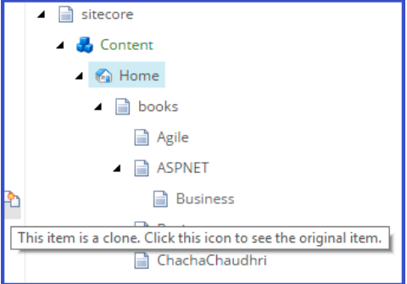
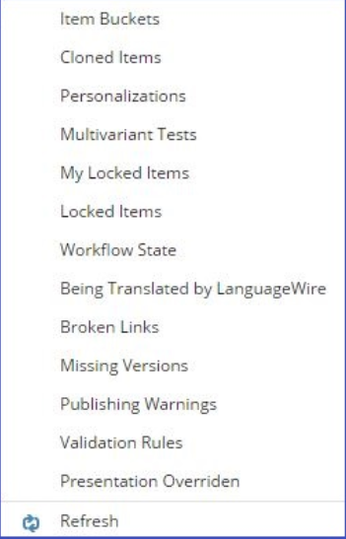
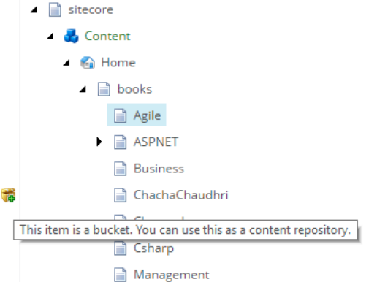
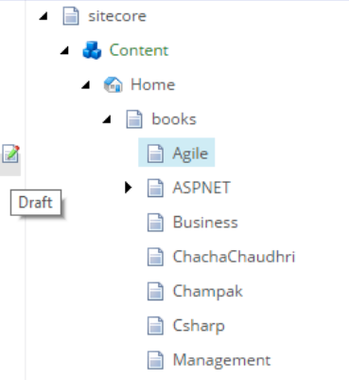
Quick Action bar
Nunc viverra imperdiet enim. Fusce est. Vivamus a tellus.

Slide 10
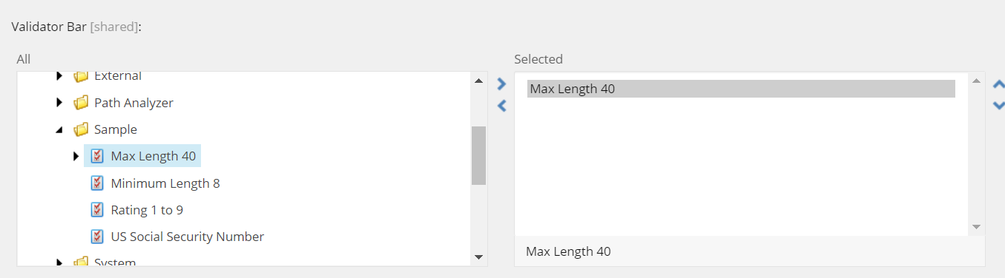
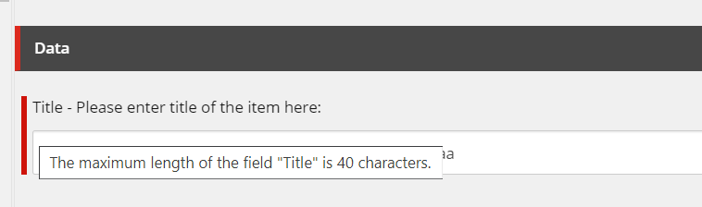
Validator Bar
Nunc viverra imperdiet enim. Fusce est. Vivamus a tellus.

Slide 11
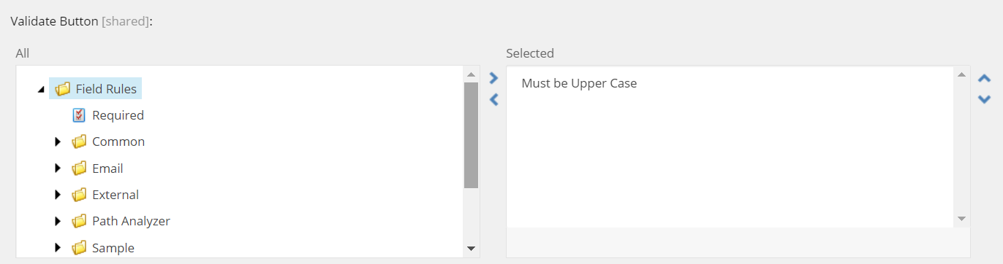
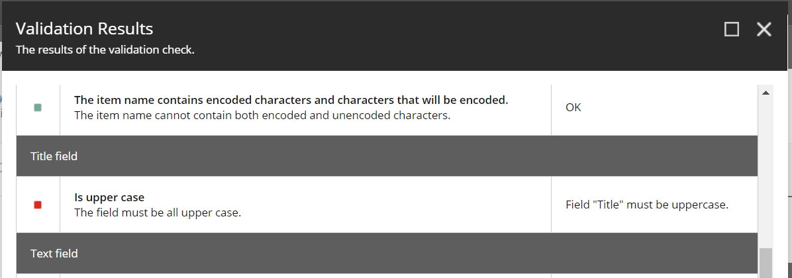
Validation button
Configuration & Action

Slide 12
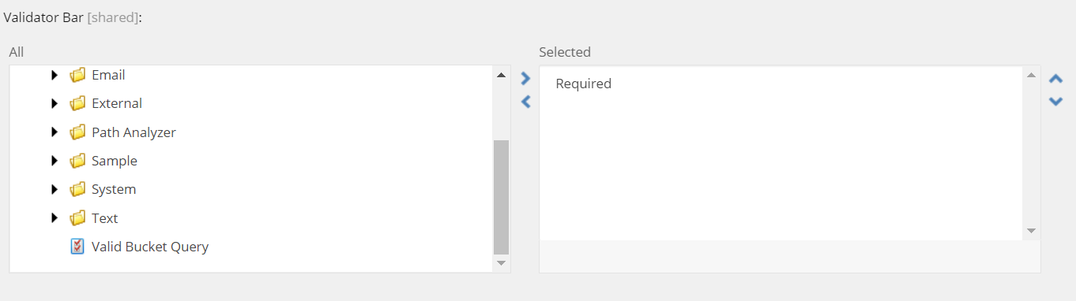
Validation bar
Configuration & Action – both content authoring & experience authoring

Slide 13
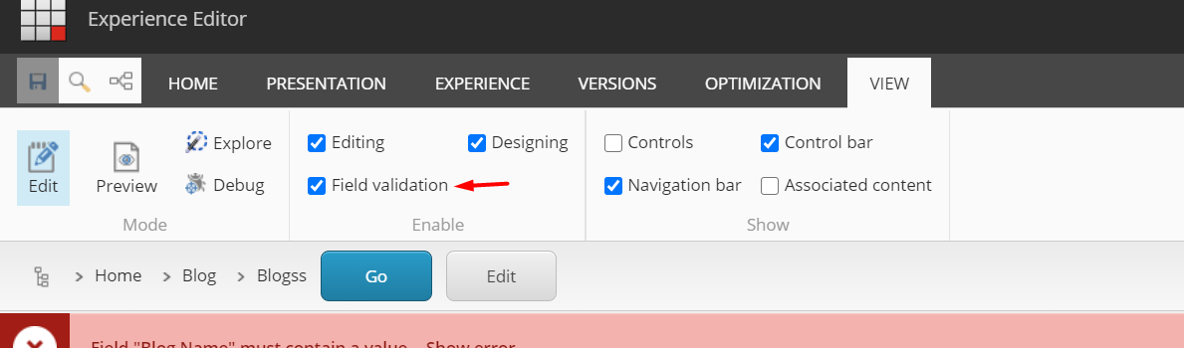
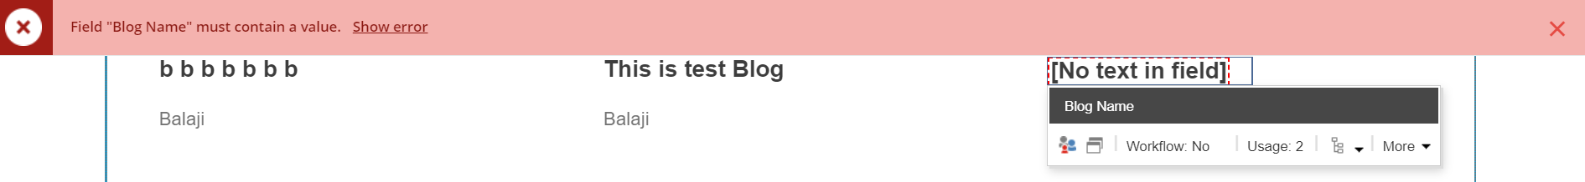
Validation bar
Configuration & Action

Slide 14
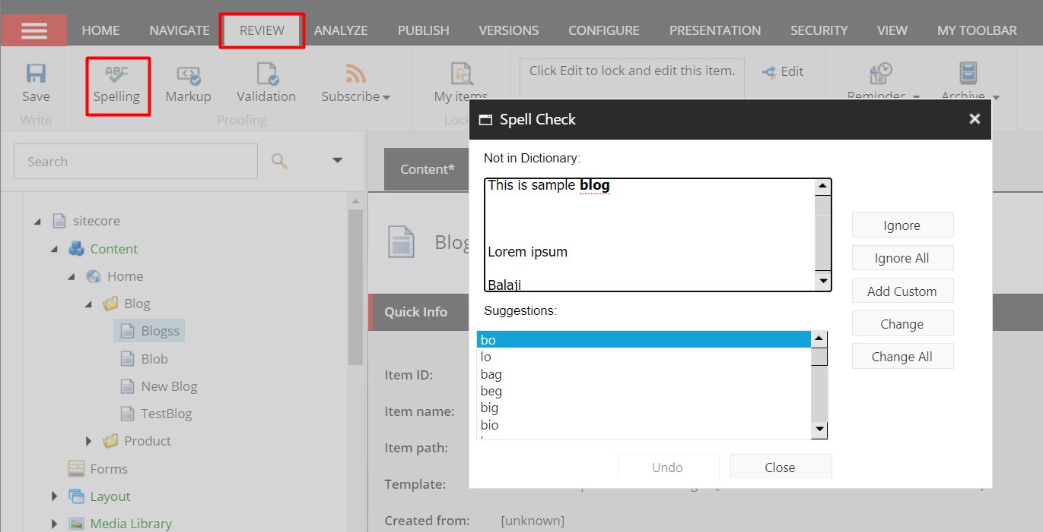
Spelling
Configuration & Action

Slide 15
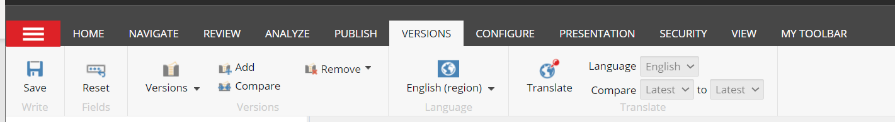
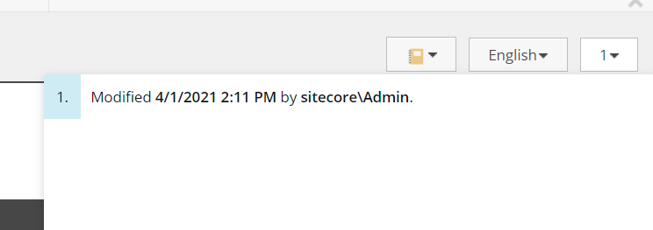
Item versions
Configuration & Action

Slide 16
Thank you

